Slide 1
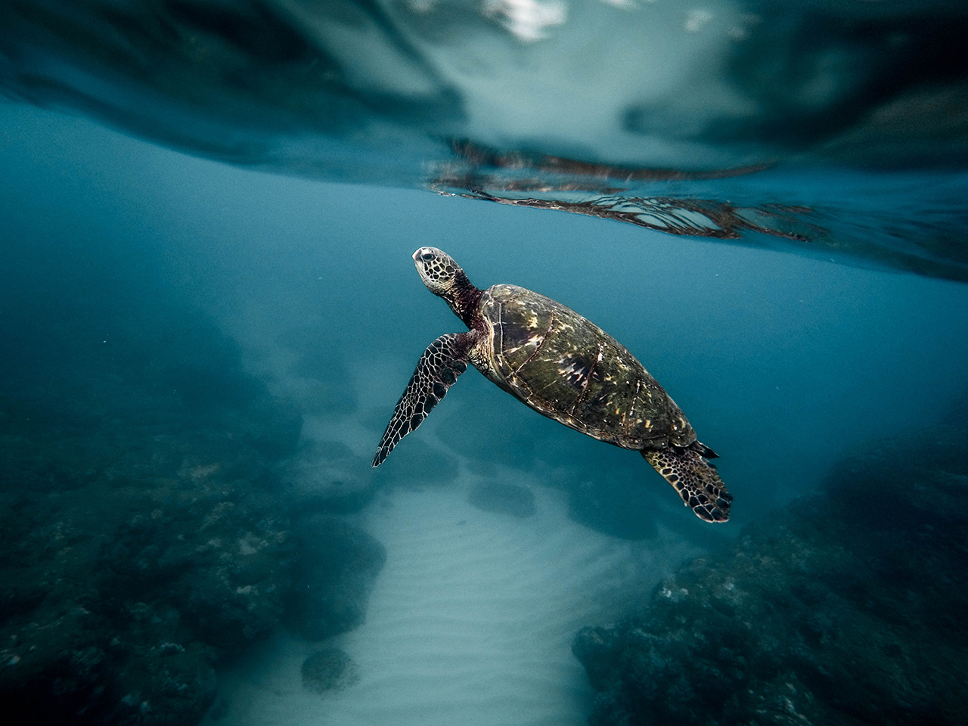
Final Project Presentation
Gabriel Mañeru

Slide 2
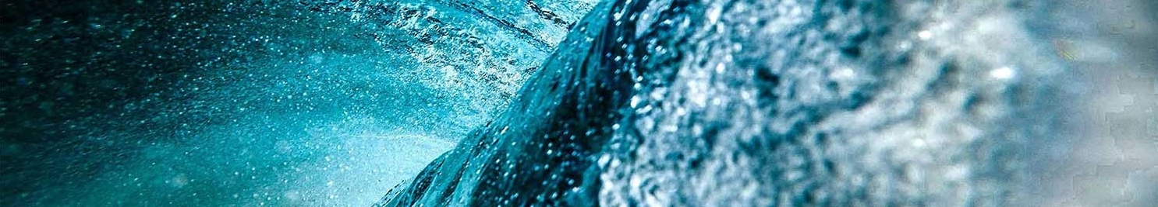
Real-time Water Rendering
2

Slide 3
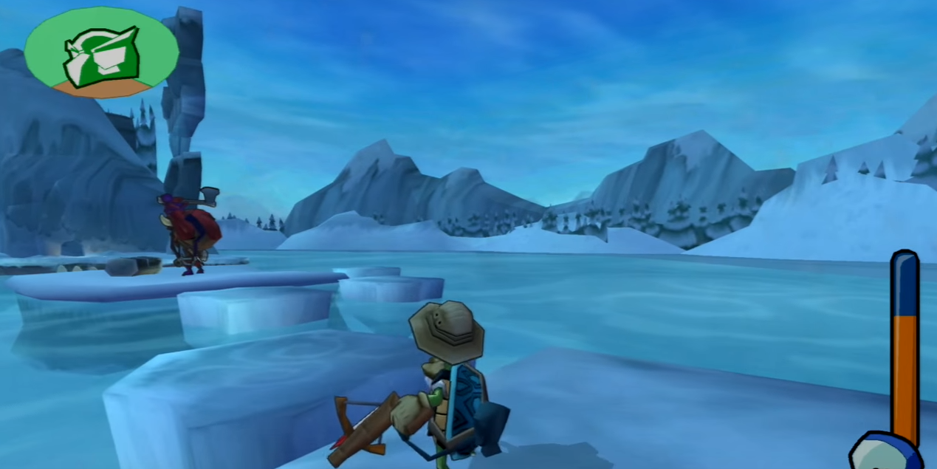
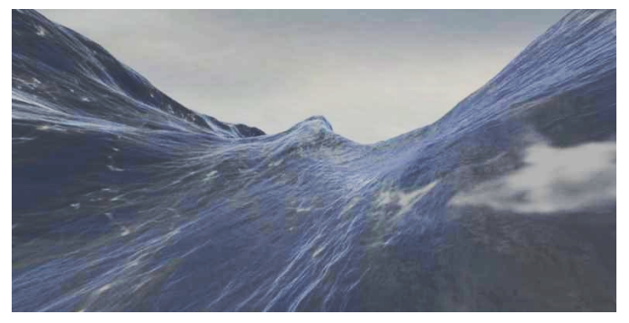
Problem Description
Model
Simple Water Texture
Not too realistic
Planar movement
Trivial Implementation
Fast Fourier Transforms
Most realistic
Fluid dynamics
Too much computations for
real-time application
Sly cooper 2 - 2004
Simulating Ocean Water – Tessendorf - 2001

Slide 4
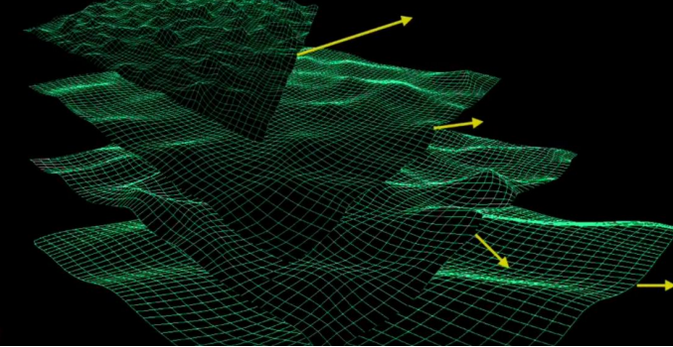
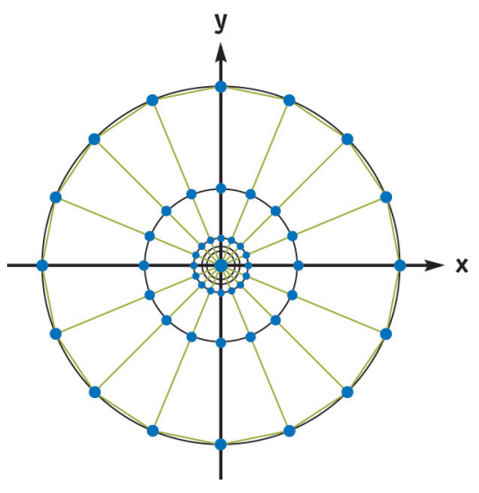
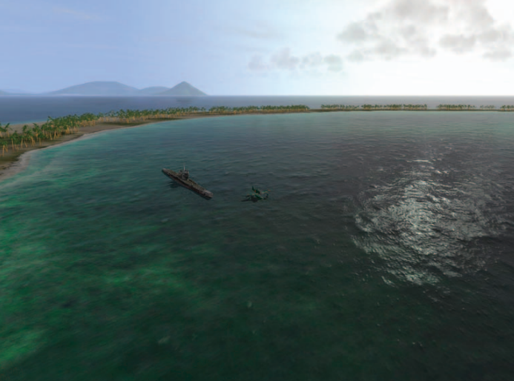
Paper Implementation Details
Model: Simulate displacement using superposition of height maps
2 with Low Frequency for vertex displacement
4 with High Frequency for lighting calculations
LOD: Sample using a Radial Grid centered at the camera
that serves as tessellation.
Shading: Simple lighting assuming the water is flat

Slide 5
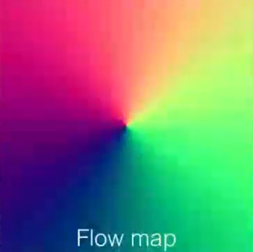
Actual Implementation : Model
Global motion into local motion.
Superposition of height maps
Mesh out of layers representing each wave.
Layer : speed, wavelength and height.
A layer can flow in any direction (based on a flow map)
Problem : UV displacement:
Layer : interpolates multiple height maps:
Displace UV’s along the flow direction
Interpolate between two maps using new UV’s
Swap the height maps when they are in phase
Uncharted 4
Siggraph16’
Uncharted 4
Siggraph16’
Uncharted 4
Siggraph16’

Slide 6
Actual Implementation : LOD
None implemented
Focused:
Single chunk
Shading
Game usage

Slide 7
Actual Implementation : Shading
Shoreline water
Local Reflections (SSR)
Global Reflection
Water Refraction
Caustics
Phong lightning
Simple Foam
Simple Buoyancy

Slide 8
Demo Time
Insertar imagen

Slide 9
Improvements
Flow map creation tool (Direction / Height)
Second diffuse pass (for refraction)
Shadows
Particle System

Slide 10
Questions?
Insertar imagen

